Slide 1
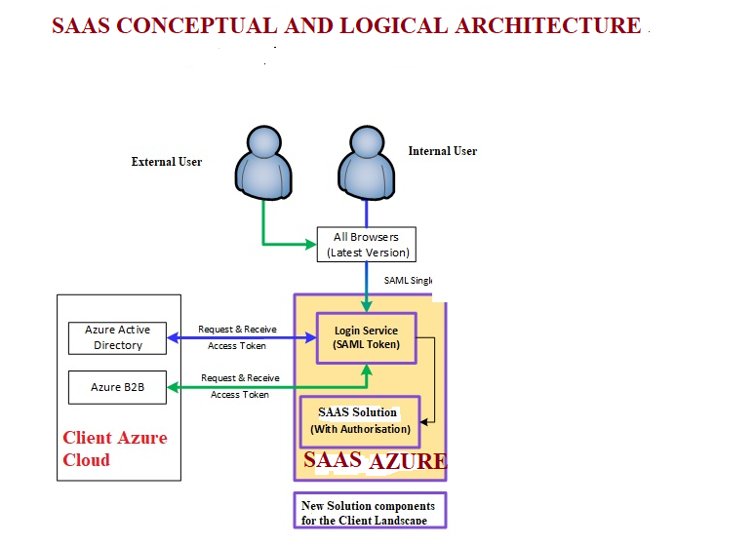
REQUIREMENT
Design a more detailed architecture for this SAAS solution incorporating all components of this high level design which has been approved. Security features must be incorporated e.g. Two factor authentication etc. The architecture must be done in powerpoint and a step by step process for implementating the SAAS solution must be documented so that the clients technical team understands the process and whats required. Provide an option for high availability as well.

Slide 2
